Slide 1

Department of CE/IT
FOOD ORDER SYSTEM
Mini Project
OODP (01CE1303)
Name : Haresh Baraiya
Enrollment No :
91900103047
Class : TC1
Batch : Lab-C

Slide 2
Introduction
This project is about Food ordering system.
In today's age of fast food and take-out, many restaurants have chosen to focus on quick preparation and speedy delivery of order rather than offering a rich dining experience.

Slide 3
Functionality
List of basic functionalities
1. Add record.
2. Display record.
3. Search record.
4. Delete record.
5. Modify record.

Slide 4
Strength of Project
Reason for selecting this definition because, this definition is all about food delivery system, so in this definition we can do more with this definition.
Advantage of this project is, output of records are arranged in very well manner, no other extra details are there, only useful details are there.
This project is useful because, this project is very simple, user will not face any trouble while he/she will exploring this project.

Slide 5
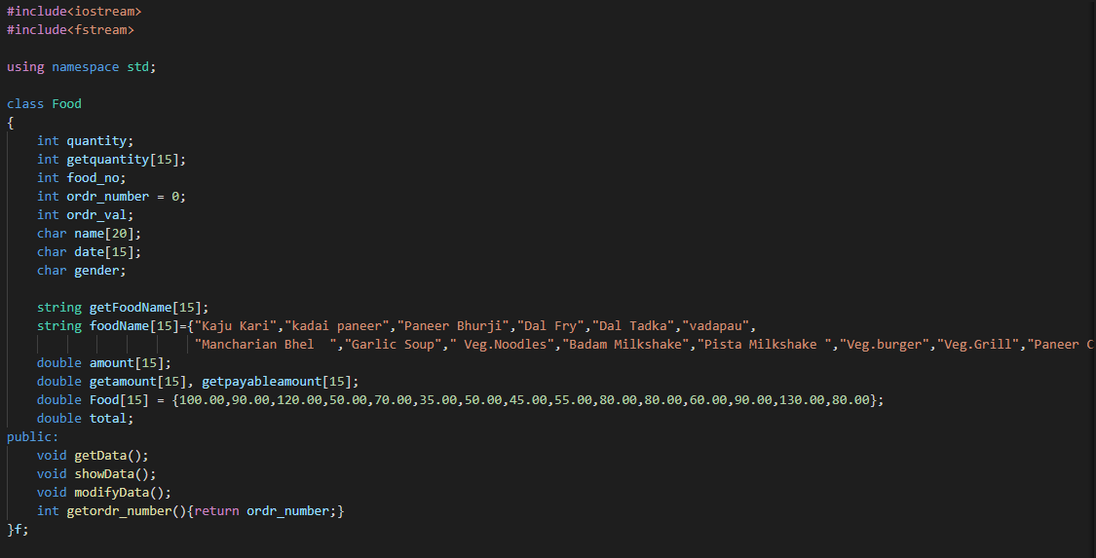
Sample Coding screen shots

Slide 6
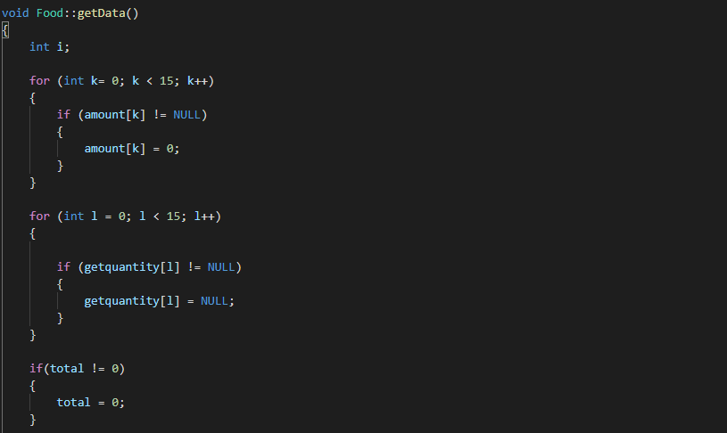
Sample Coding screen shots

Slide 7
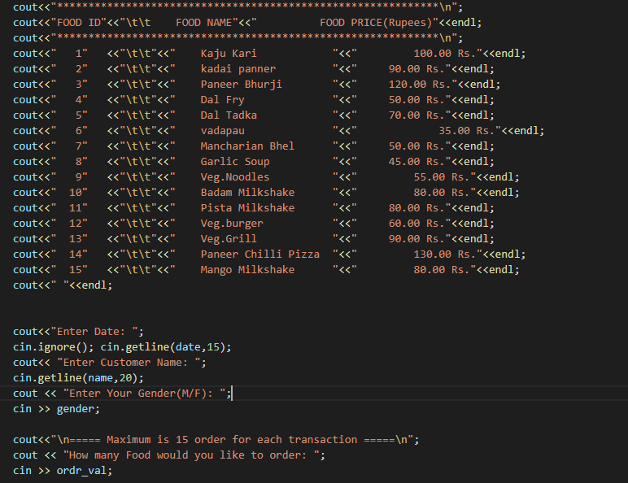
Sample Coding screen shots

Slide 8
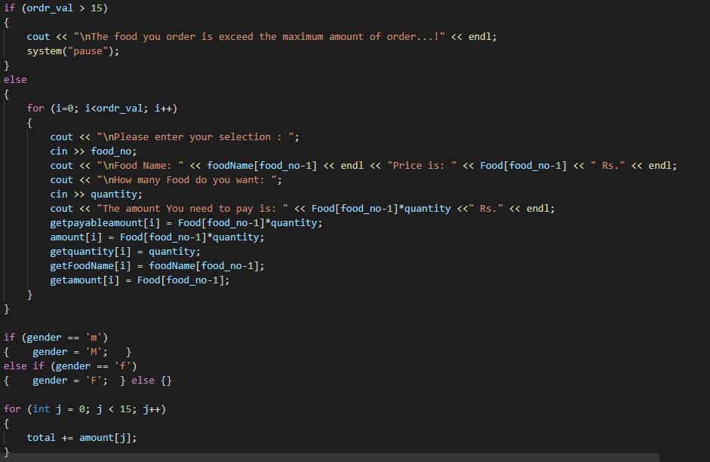
Sample Coding screen shots

Slide 9
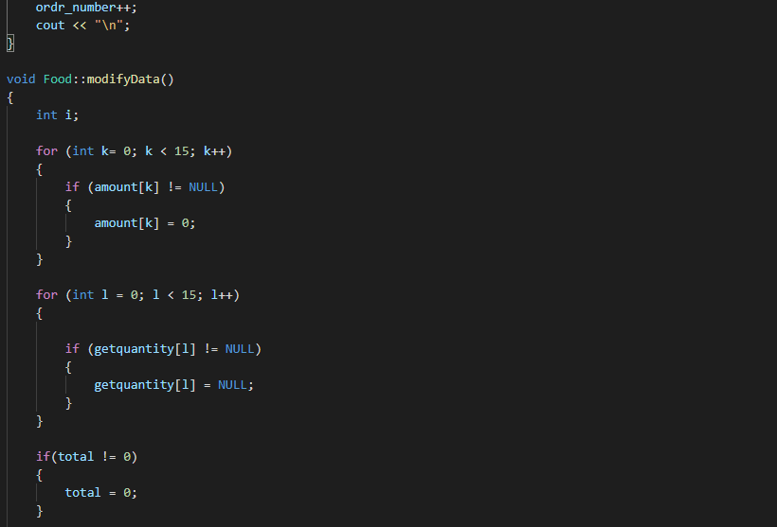
Sample Coding screen shots

Slide 10
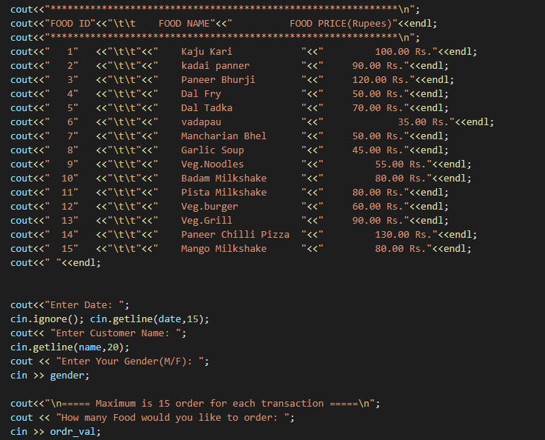
Sample Coding screen shots

Slide 11
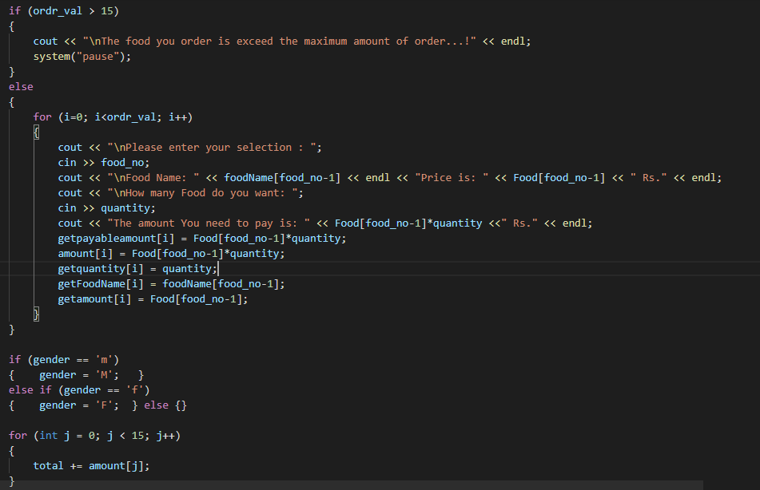
Sample Coding screen shots

Slide 12
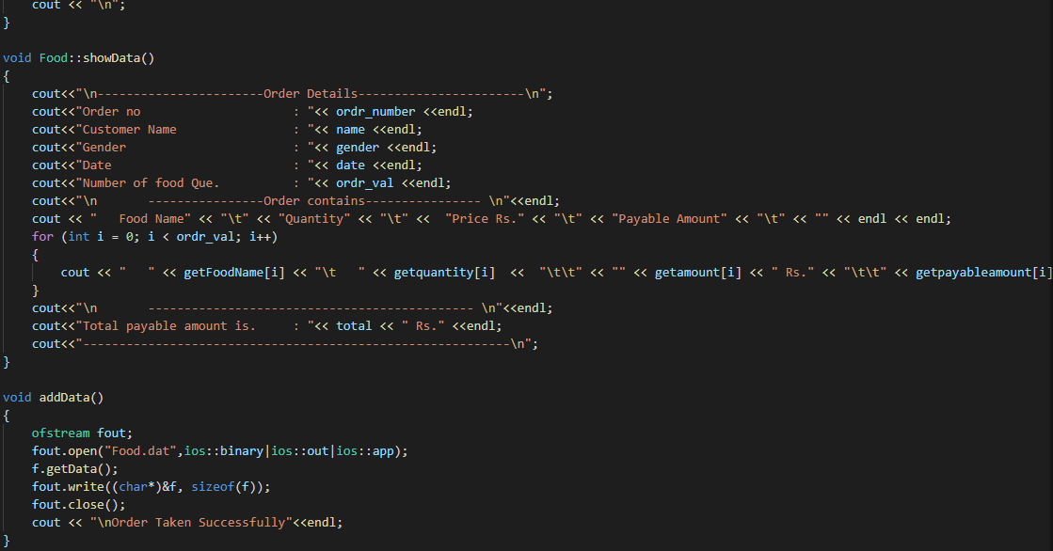
Sample Coding screen shots

Slide 13
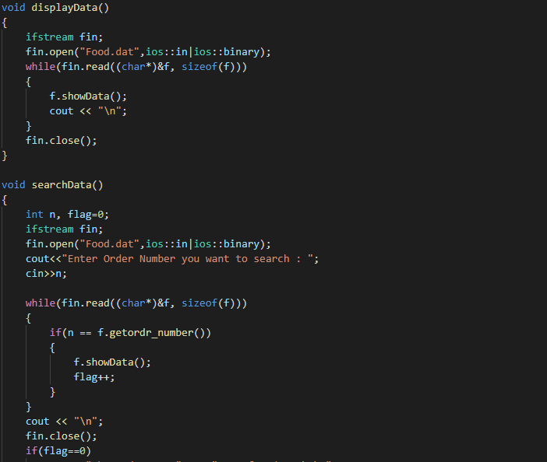
Sample Coding screen shots

Slide 14
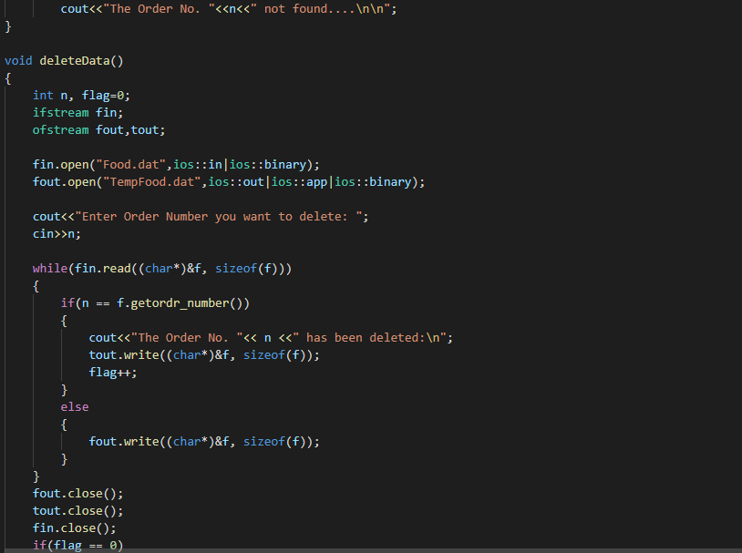
Sample Coding screen shots

Slide 15
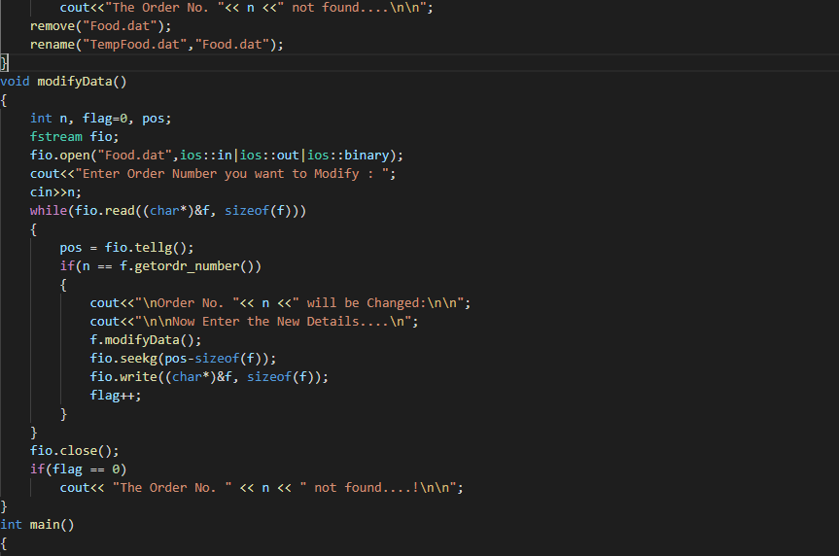
Sample Coding screen shots

Slide 16
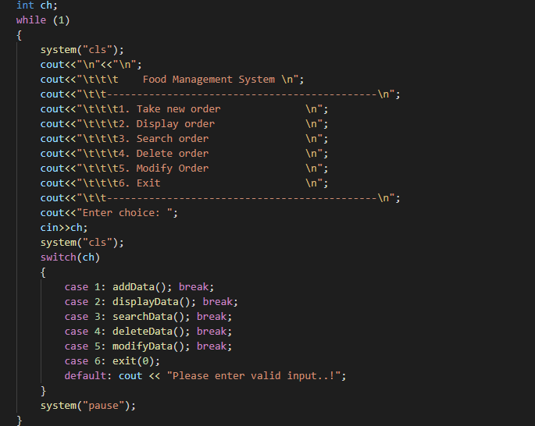
Sample Coding screen shots

Slide 17
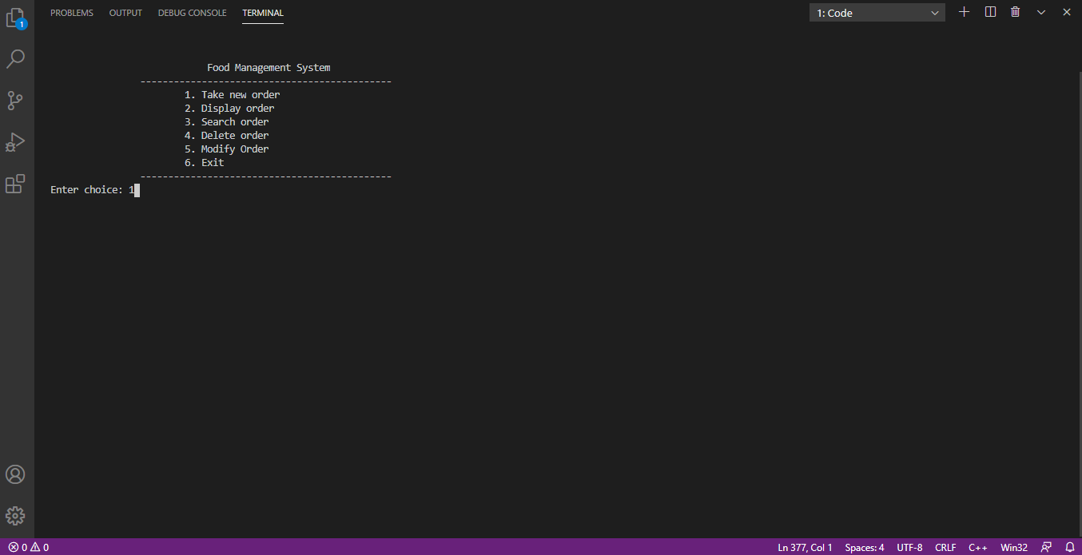
Sample Output Screenshots Add record

Slide 18
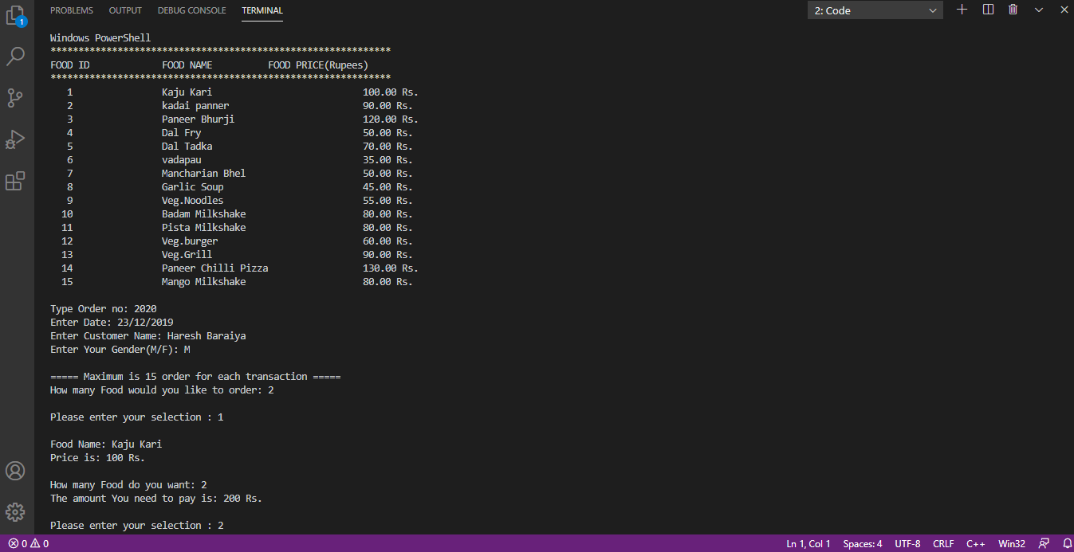
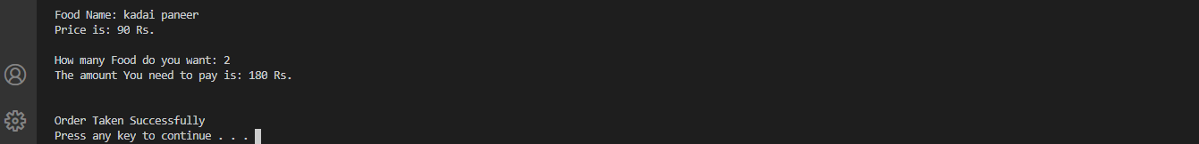
Sample Output Screenshots Add record

Slide 19
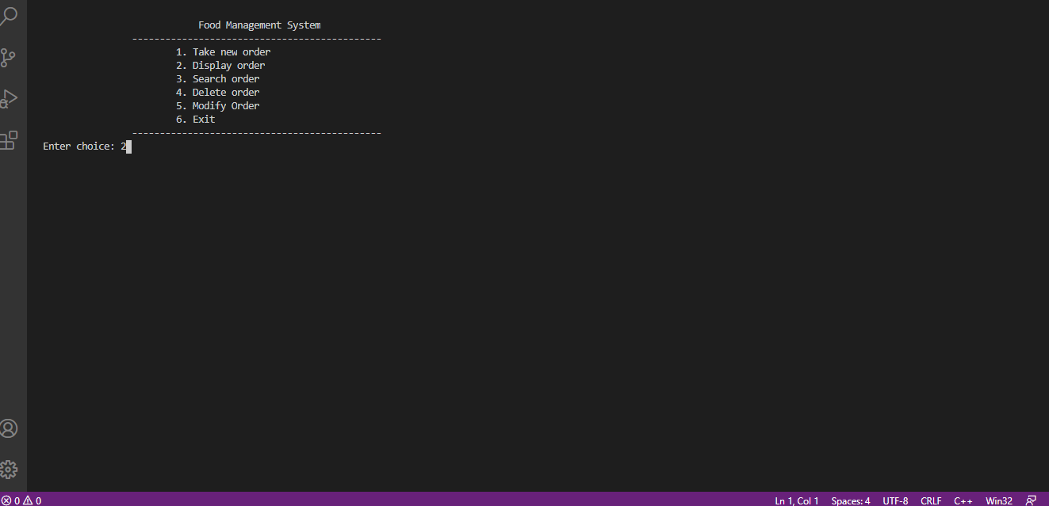
Sample Output Screenshots Display record

Slide 20
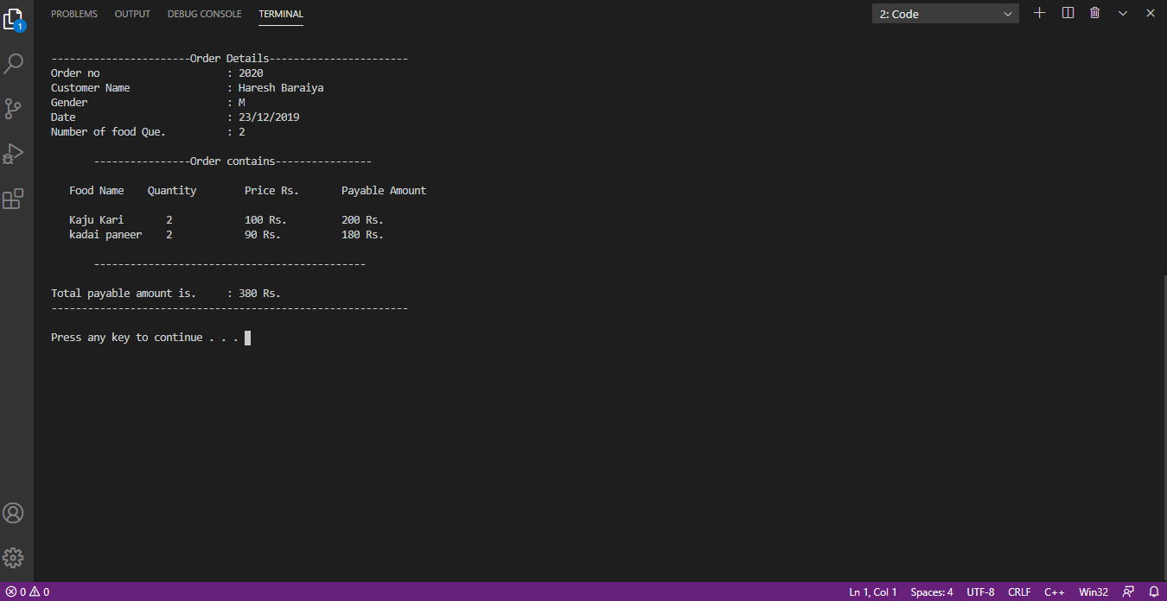
Sample Output Screenshots Display record

Slide 21
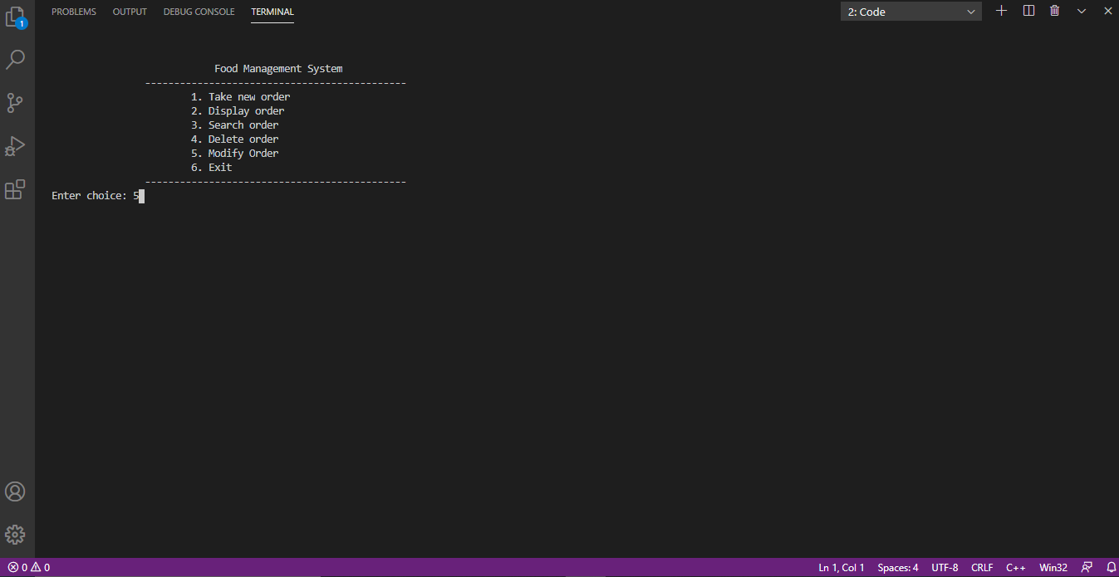
Sample Output Screenshots Update record

Slide 22
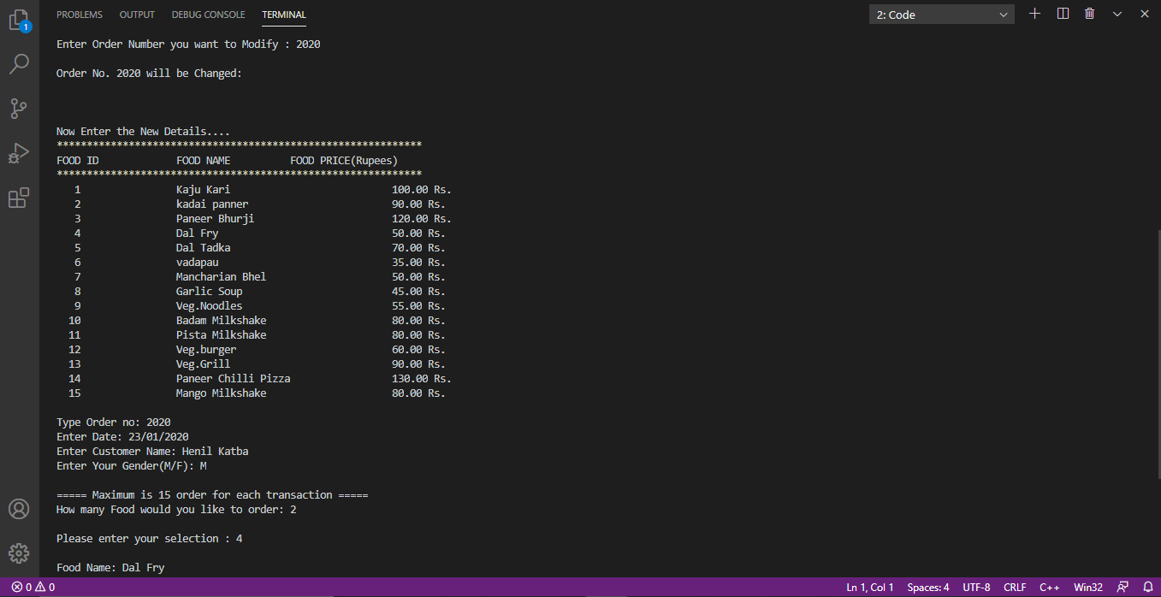
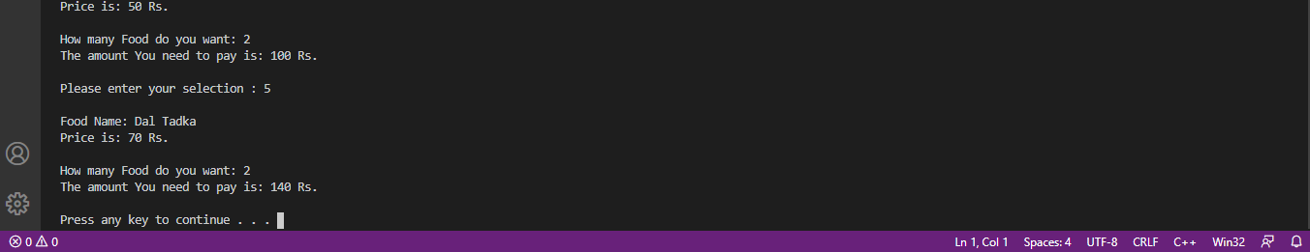
Sample Output Screenshots Update record

Slide 23
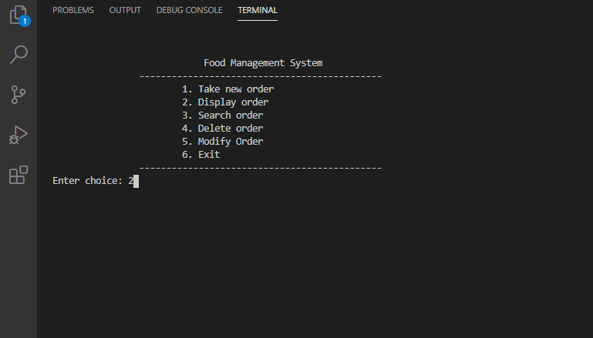
Sample Output Screenshots Display record

Slide 24
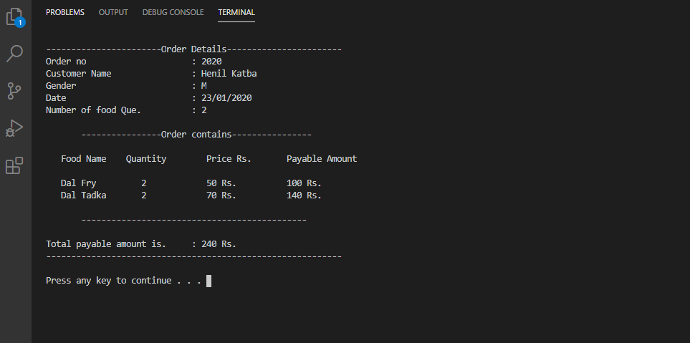
Sample Output Screenshots Display record

Slide 25
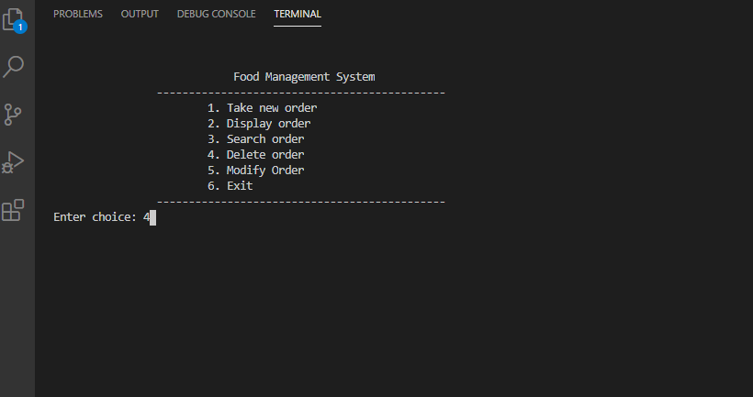
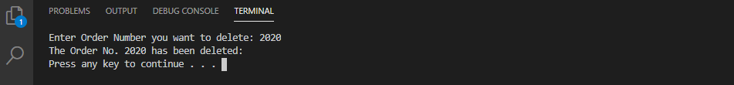
Sample Output Screenshots Delete record

Slide 26
Limitations / Extension
limitations of this project is, I take limited amount of quantity of food in this project, and somehow this project cannot deal with real scenario of food delivery system.
If I talk about Extension then this project is expandable, we can add more quantities of food whenever there is availability.

Slide 27
Thank you

